Slide 1

Transformer-Based Model for Vessel Route Forecasting and Anomaly Detection
Studente
Alessandro Marzilli – 1811092
Relatore
Prof. Danilo Comminiello
Correlatore
Ing. Claudio Greco
Engineering in Computer Science Dipartimento di Ingegneria informatica, automatica e gestionale
Facoltà di Ingegneria dell'informazione, informatica e statistica
Anno Accademico 2022-2023
Sapienza University of Rome
Notes:
Good morning to everyone today I will present the work “transformer-based model for vessel route forecasting and anomaly detection”.

Slide 2
In collaboration with:
Elman s.r.l. is a Italian manufacturer specializing in shipborne and land-based Automatic Identification Systems (AIS) equipment for both military and civil applications.
Notes:
The thesis is carried out in collaboration with Elman s.r.l., a Italian manufacturer specializing in shipborne and land-based Automatic Identification Systems (AIS) equipment for both military and civil applications.

Slide 3
Table of contents
Introduction
AIS Dataset
Vessel Route Forecasting
Anomaly Detection
Future Works
Notes:
In the following I will provide a brief introduction about the background of the thesis, I will describe the datasets used, I will present the tasks addressed in this work, the vessel route forecasting and the anomaly detection task, and finally I will discuss the future works of the thesis.

Slide 4
1. Introduction
The maritime industry has experienced a profound transformation in recent years, driven by the increased accessibility of data (AIS data) and the advancements in deep learning techniques.
The thesis aims to enhance safety and security measures by supporting and simplifying the work of Port Authorities, Rescue teams and other parts.
Transformer-Based Model for Vessel Route Forecasting and Anomaly Detection - Alessandro Marzilli
Notes:
By developing these tasks, the thesis aims to improve the services provided by the maritime industry.
By exploiting deep learning techniques the goal is to enhance safety and security measures by supporting and simplifying the work of Port Authorities, Rescue teams, and other stakeholders

Slide 5
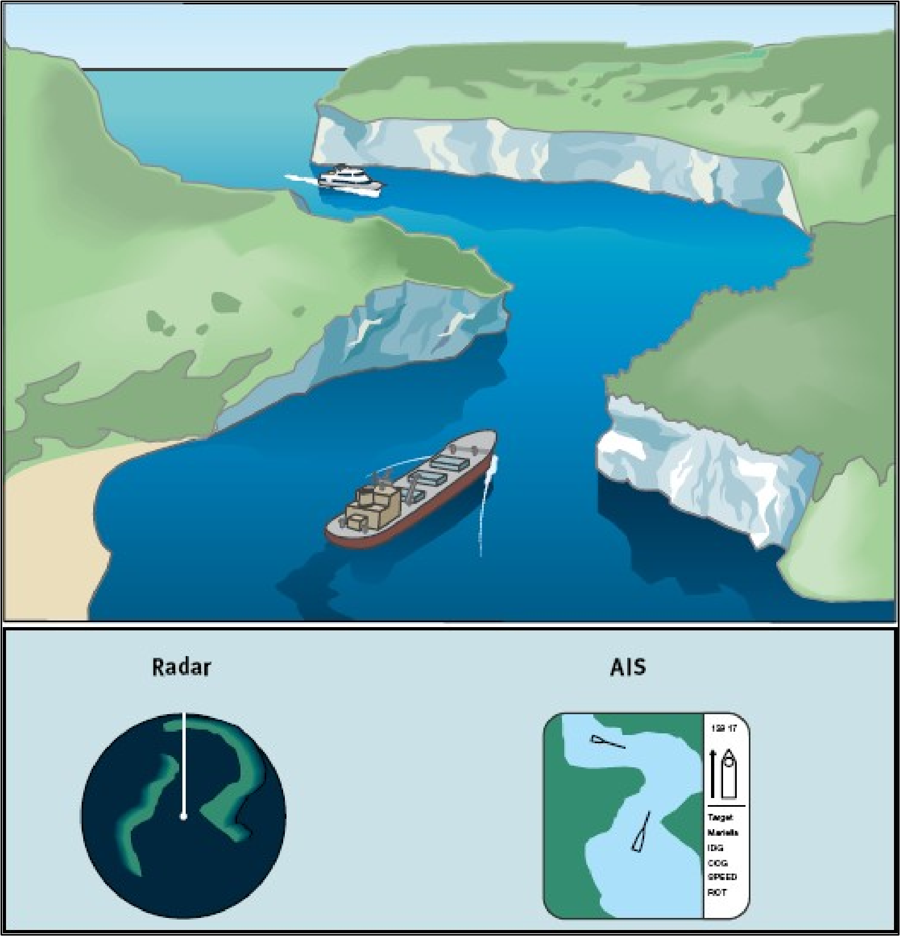
Introduction: AIS Background
AIS is a tracking system that uses transponders on ships to transmit and receive data, providing real-time information about vessel movements and characteristics.
AIS enables effective collision avoidance, helps in search and rescue operations, and assists in the detection of potential security threats, such as piracy and smuggling.
AIS collision avoidance
Transformer-Based Model for Vessel Route Forecasting and Anomaly Detection - Alessandro Marzilli
Notes:
To implement the tasks addressed from the research we used the AIS data.
AIS is a tracking system that uses transponders to transmit and receive data, providing real-time information about vessel movements and characteristics.
By supplying real time information about nearby vessels, AIS enables collision avoidance, helps in search and rescue operations, and assists in the detection of potential security threats, such as piracy and smuggling.

Slide 6
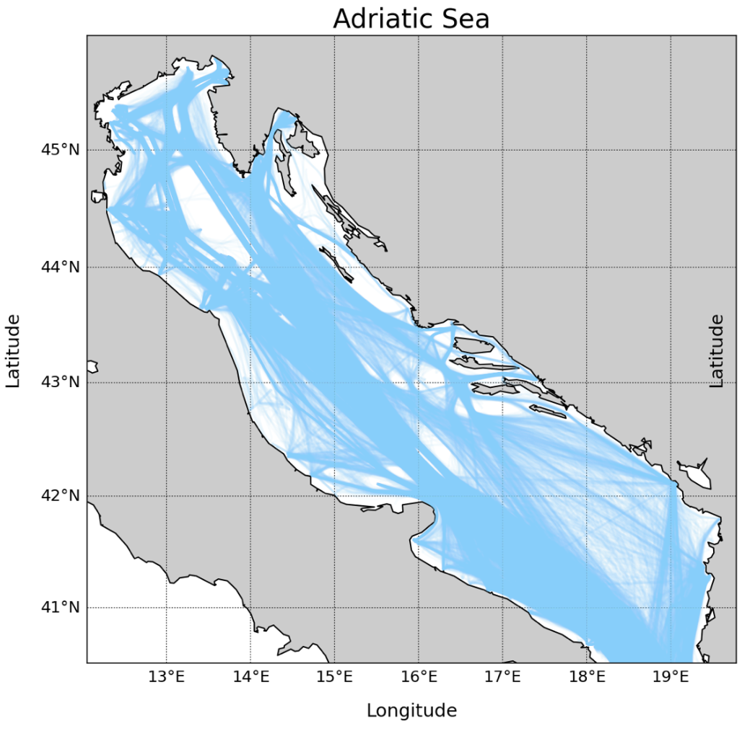
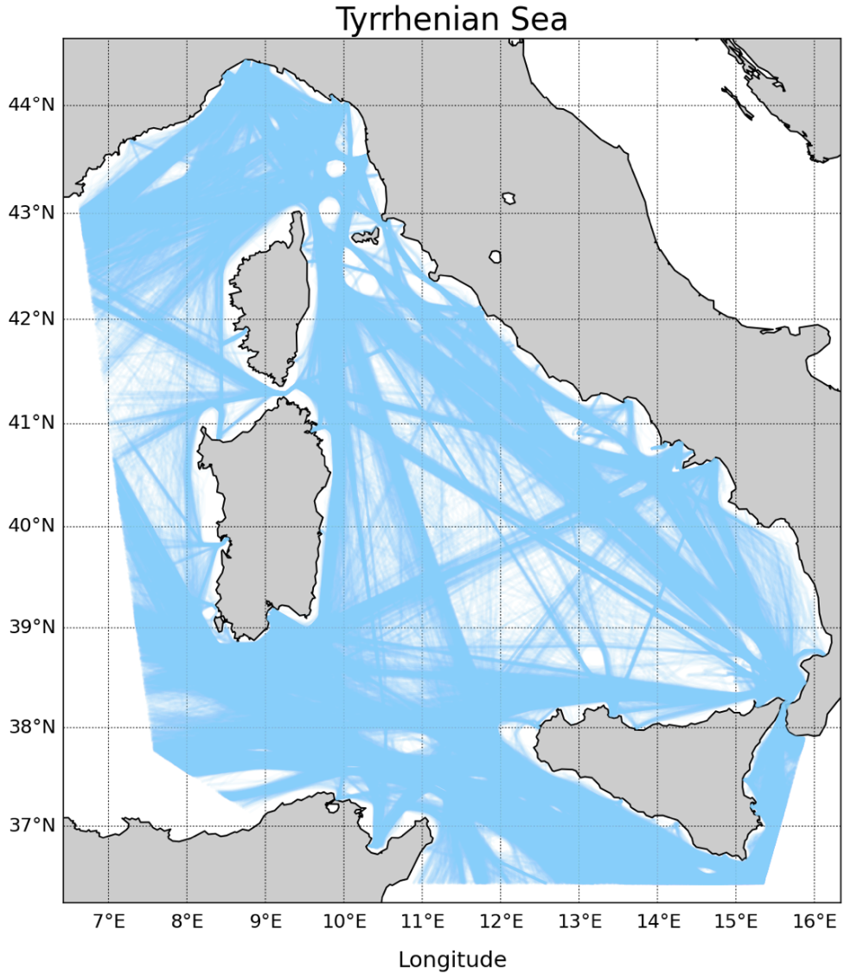
2. AIS Dataset
The AIS dataset is heterogeneous and multimodal. Each message has multiple attributes: id, type of the ship, SOG, COG, latitude, longitude, destination, ETA, heading, name.
The regions of interest (ROI) studied are from two geographical areas: the Adriatic Sea and the Tyrrhenian Sea.
From December 2021
To March 2023
From December 2021
To March 2023
Transformer-Based Model for Vessel Route Forecasting and Anomaly Detection - Alessandro Marzilli
Notes:
The AIS data used for the thesis are provided by Elman in collaboration with the italian coast guard. Both the tasks consider two datasets of AIS messages, each covering a different region of interest in the Mediterranean Sea: the Adriatic Sea and the Tyrrhenian Sea. Both of them covers a period from December 2021 to March 2023, focusing only on the winter seasons.
Each message has multiple attributes such as: the id, the type of the ship, lat, lon, sog, cog and so on. The sog is the velocity of the ship.

Slide 7
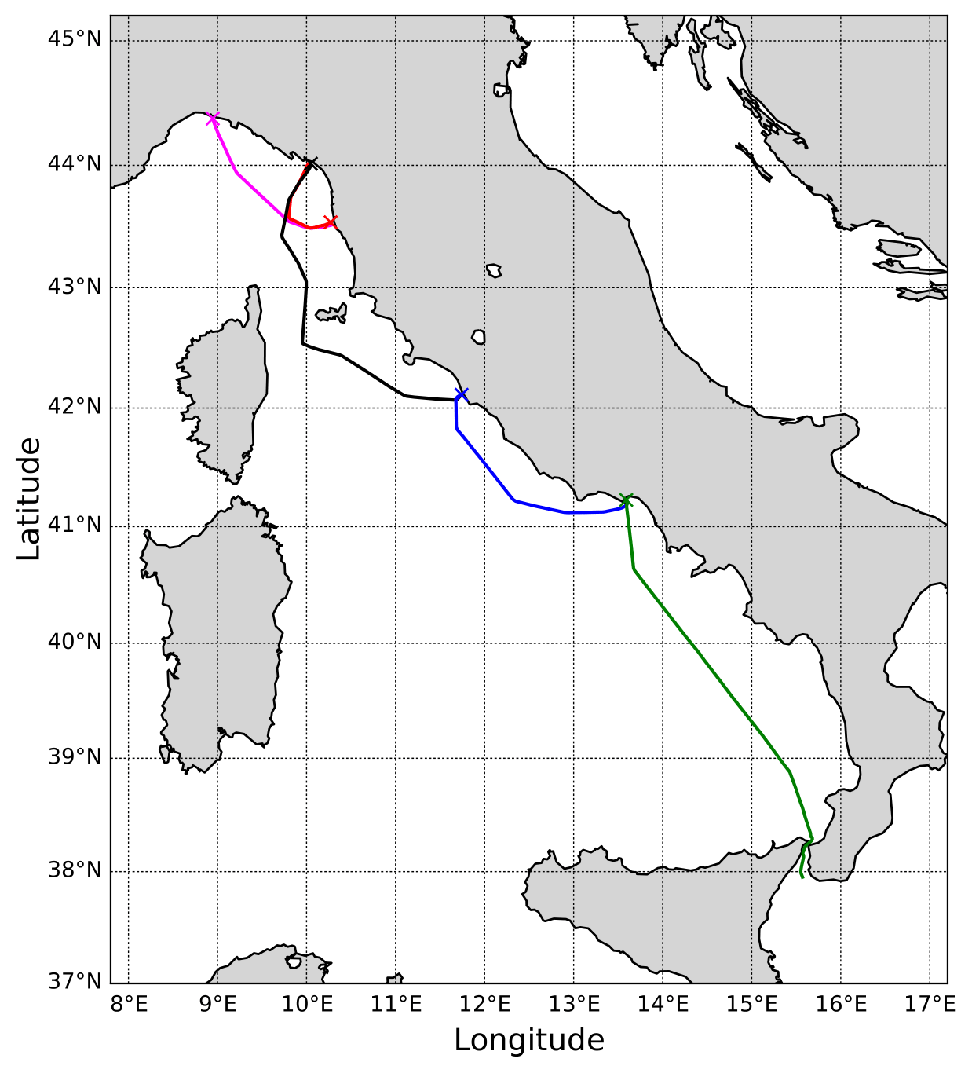
AIS DATASET: Preprocessing Phase
Only two categories are considered: cargo and tanker.
Remove null values and duplicates
Remove messages with invalid values (SOG > 30 or COG > 360°)
Remove moored or at-anchor vessels.
Delete abnormal messages (empirical speed > 40 knots)
Divide non-contiguous voyages into contiguous ones
Reme sub-tracks that are shorter than 20 messages or last less than 4 hours
Apply interpolation with a down-sampling of 6 minutes to maintain linearity in the tracks
Further splitting of the tracks greater than 20 hours
Transformer-Based Model for Vessel Route Forecasting and Anomaly Detection - Alessandro Marzilli
Sub-tracks of a single vessel obtained after the pre-processing phase
Notes:
Since the AIS messages could be noisy and sometimes contain wrong values, before performing the tasks we need to ensure the reliability of the data. Therefore, we apply a preprocessing phase consisting in 8 steps in which we remove wrong values and split long trajectories in smaller ones.

Slide 8
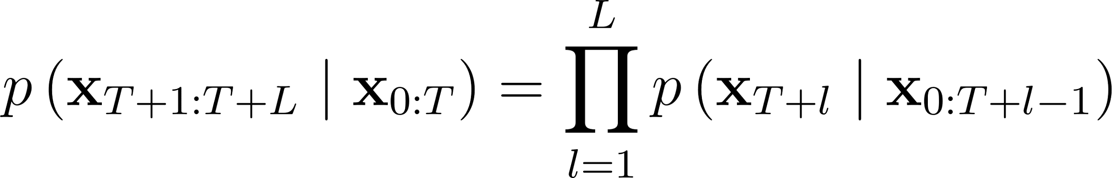
3. Vessel Route Forecasting
The task focuses on predicting the ship’s possible route in the following few hours based on its current trajectory.
Formally, given a trajectory of T+1 AIS messages, the vessel route forecasting problem can be formalized as the estimation of the next L steps ahead of a ship:
Transformer-Based Model for Vessel Route Forecasting and Anomaly Detection - Alessandro Marzilli
Notes:
The first task, the vessel route forecasting, focuses on predicting the ship’s possible route in the following few hours based on its current trajectory.
Formally, given a trajectory composed of T+1 AIS messages, the vessel route forecasting problem can be formalized as the estimation of the next L steps ahead of a ship:

Slide 9
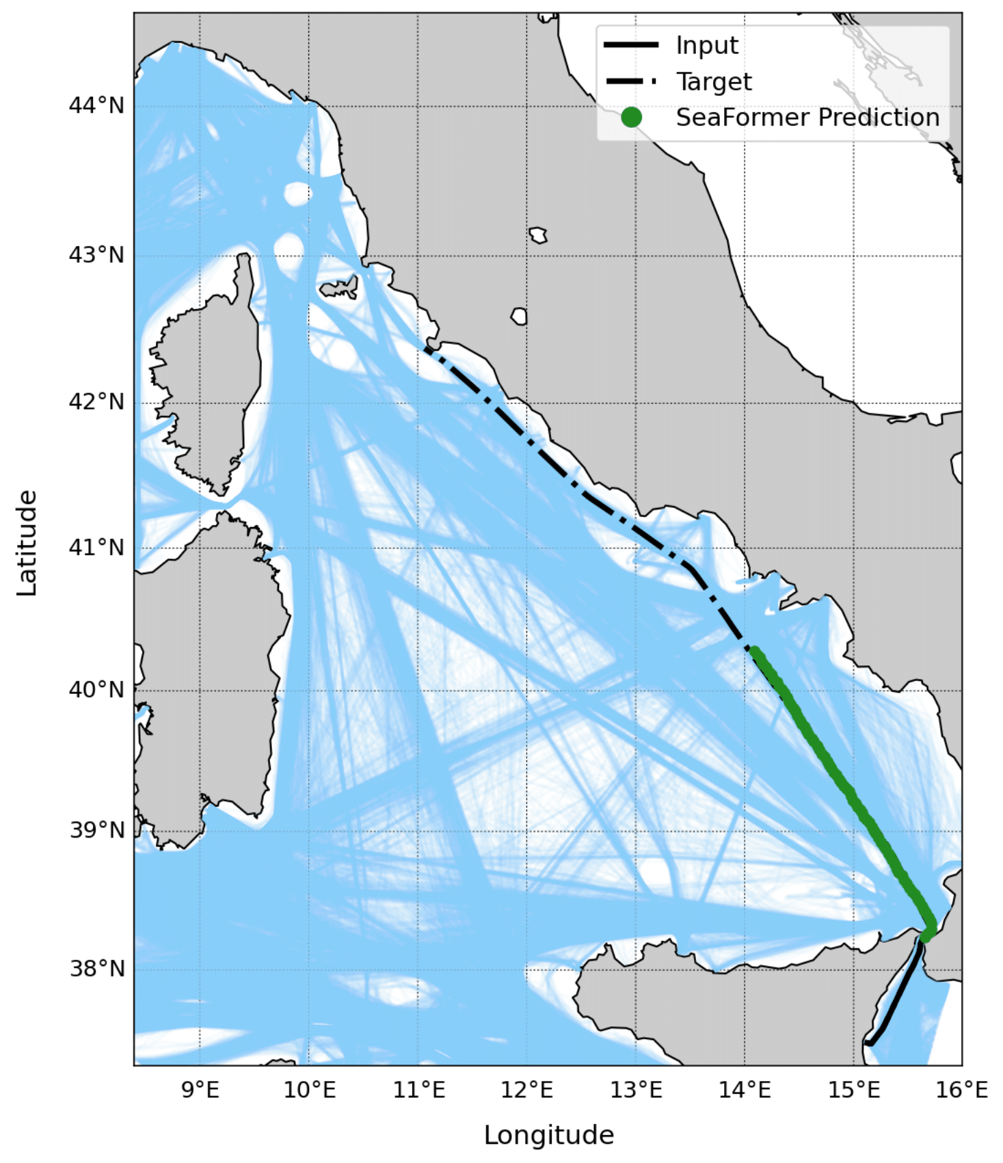
Vessel Route Forecasting:
Proposed Method
New representation of AIS data
New learning approach
SeaFormer architecture
Transformer-Based Model for Vessel Route Forecasting and Anomaly Detection - Alessandro Marzilli
Notes:
The proposed method to accomplish the task relies on 3 key innovations: a new representation of AIS data, a new learning approach, and a new model named SeaFormer is proposed.

Slide 10
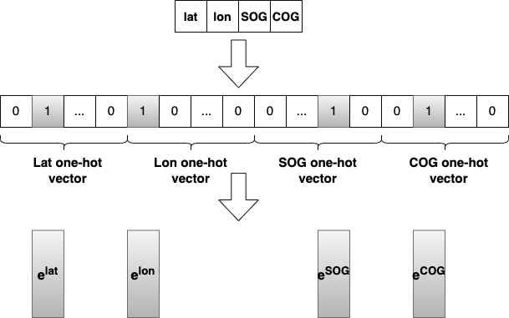



Proposed Method:
New Representation of AIS Data
A new representation of AIS data is introduced to address the issue of heterogeneity.
The key idea is to expand the message into a higher-dimensional embedding vector , by first mapping it to a 4-hot vector .
Mapping process of an AIS message
Transformer-Based Model for Vessel Route Forecasting and Anomaly Detection - Alessandro Marzilli
Notes:
A new representation of AIS data is introduced to address the issue of heterogeneity of the data.
The key idea is to expand the message to a higher-dimensional space by mapping xt to et, a high-dimensional embedding vector. However, when the dimension of et is much higher than the one of xt, training becomes extremely difficult due to overfitting. To overcome these overfitting problems, an intermediate mapping process is performed and xt is first mapped to a "four-hot" vector ht.

Slide 11
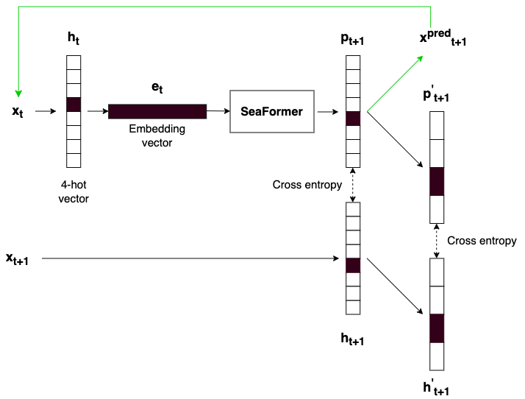
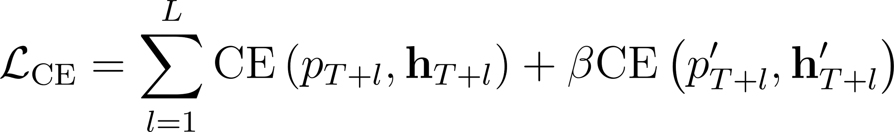
Proposed Method: New Learning Approach
Given the new data representation, the problem can be formulated as a classification problem.
Loss function definition:
high resolution
low resolution
Transformer-Based Model for Vessel Route Forecasting and Anomaly Detection - Alessandro Marzilli
Notes:
Given the new data representation, the problem can be formulated as a classification problem. Indeed, now we have the prediction of 4-hot vectors, so the problem naturally becomes a classification problem with 4 heads.
The loss is a multi-resolution cross-entropy loss: it consists in computing the cross entropy at different resolutions to improve the prediction.

Slide 12
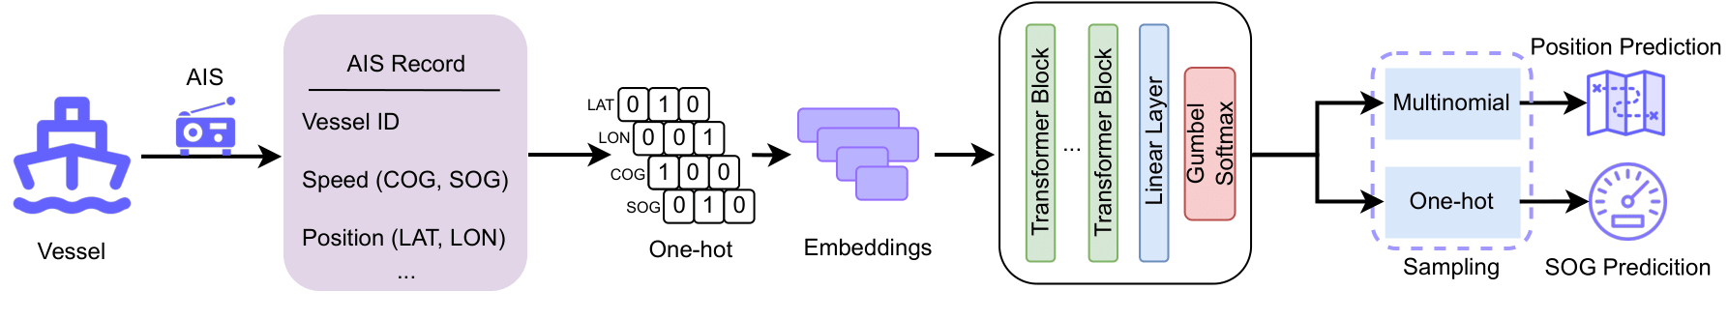
Proposed Method: SeaFormer Architecture
The architecture of the proposed SeaFormer is based on transformer-like models, specifically a GPT model.
Key innovations:
Gumbel Softmax as final activation function
Different sampling function for the position and the SOG prediction
Transformer-Based Model for Vessel Route Forecasting and Anomaly Detection - Alessandro Marzilli
Notes:
The architecture of the proposed SeaFormer is based on transformer-like models, specifically a GPT model.
The key innovations are: The Gumbel Softmax as the final activation function and the implementation of different sampling strategies for the position and the SOG prediction.
The Gumbel-Softmax is a differentiable approximation of the categorical distribution that allows for stochastic sampling during training, producing a discrete probability distribution over a set of categorical outcomes.
To predict the position of a vessel a multinomial distribution is employed after the Gumbel-Softmax to introduce a stochastic factor into the prediction. This is essential because two ships with the same speed and trajectory may diverge in different directions at a certain point. Therefore, incorporating a probabilistic factor to predict the next sample based on the current trajectory is appropriate.
For the sog prediction we don’t need this probabilistic factor, so the one-hot vectors obtained directly from the Gumbel-Softmax are used to address this issue and achieve better predictions for the SOG values.

Slide 13
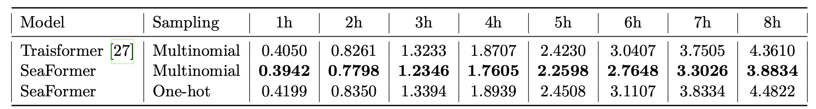
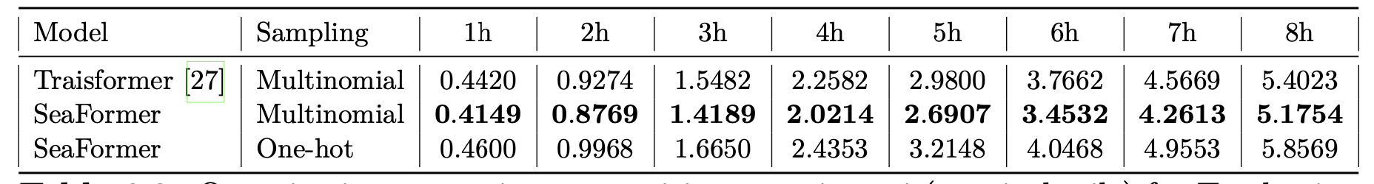
Vessel Route Forecasting: Position Prediction
Metrics: A best-of-N criterion is used to evaluate the model. Then, the haversine distance between the true and predicted values is computed for the error on the position.
Quantitative comparison on position error in mni (nautical mile) for Adriatic sea
Quantitative comparison on position error in mni (nautical mile) for Tyrrhenian sea
Transformer-Based Model for Vessel Route Forecasting and Anomaly Detection - Alessandro Marzilli
Notes:
Now I will present the results of the experiments of the vessel route forecasting task, considering both the Adriatic and the Tyrrhenian datasets. First I will show the results for the position prediction and then the ones of the SOG prediction.
The position prediction is evaluated using the best-of-N criterion. N is set to 16 and ultimately only the prediction with the lowest error is considered. Then, the haversine distance between the true and predicted values is computed for the error on the position.
In the first table, there are the experiments for the Adriatic Sea, while the second table contains the results of the Tyrrhenian Sea. From both tables, we can clearly see that the results obtained with our model, the Seaformer, (in the second rows) outperform the current state-of-the-art model, the Traisformer, whose results are shown in the first rows.

Slide 14
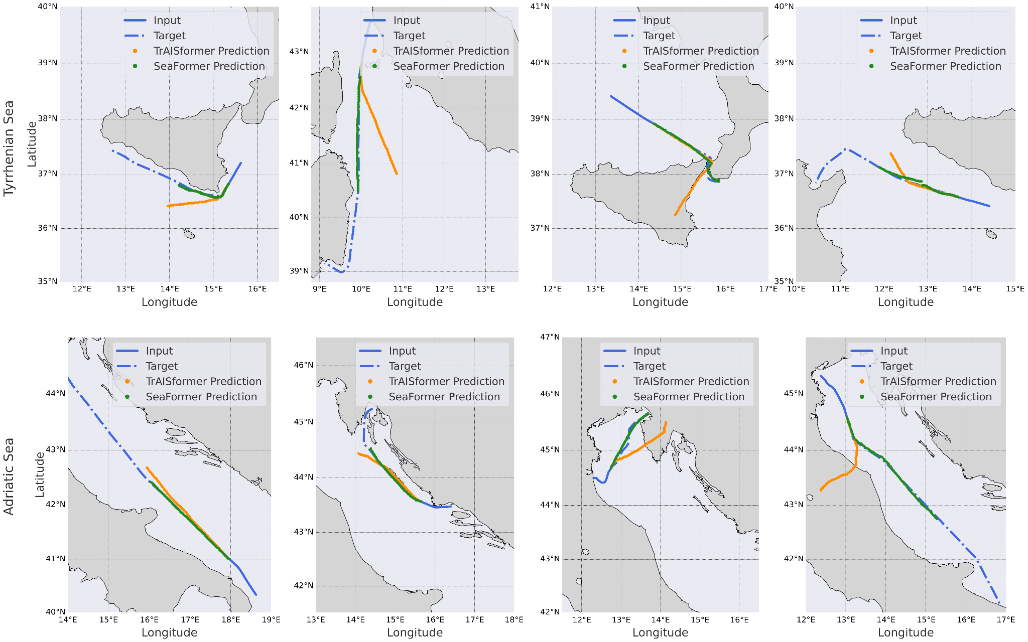
Vessel Route Forecasting: Position Prediction
Transformer-Based Model for Vessel Route Forecasting and Anomaly Detection - Alessandro Marzilli
Notes:
Also, from a graphical representation, we can see how good our model is compared with the Traisformer. In this slides some random samples of the predictions for the Adriatic dataset are shown. The green lines indicate the predictions of our model, the orange lines denote the predictions of the Traisformer and the blue lines indicate the target trajectories.

Slide 15
Vessel Route Forecasting: Position Prediction
Transformer-Based Model for Vessel Route Forecasting and Anomaly Detection - Alessandro Marzilli
Notes:
These are some random samples for the Tyrrhenian dataset. We can clearly see that the SeaFormer can effectively model more challenging routes, as demonstrated by the accurate prediction of the vessel passing through the narrow of Messina in the third column, while the baseline model predicts the vessel to be on land.

Slide 16
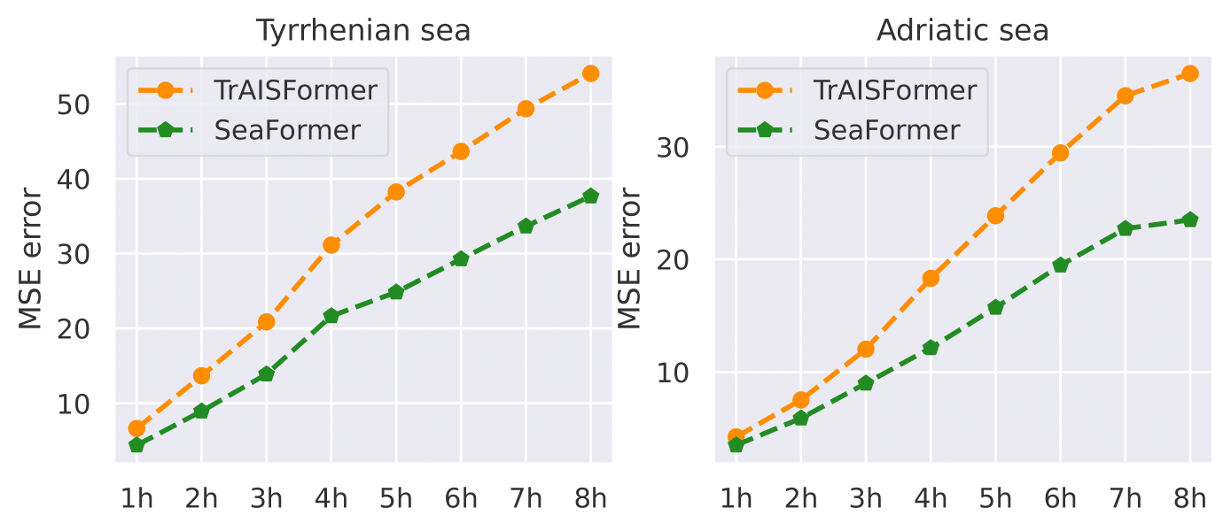
Vessel Route Forecasting: SOG Prediction
Metrics: the mean squared error (MSE) metric is used.
Comparison of MSE error for SOG predictions
Transformer-Based Model for Vessel Route Forecasting and Anomaly Detection - Alessandro Marzilli
Notes:
For the Speed Over Ground (SOG) prediction, the mean squared error (MSE) metric is used. In this case as well, we achieve better results than the baseline model, the Traisformer. Indeed, the error for our model is almost two times better than that of the Traisformer.

Slide 17
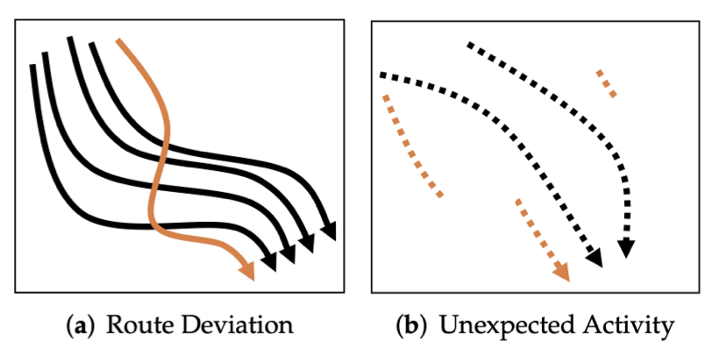
4. Anomaly Detection
The task aims to detect unusual or anomalous trajectories that deviate from expected patterns.
This task helps in identifying potential threats, security breaches, or abnormal vessel activities that require further investigation or intervention.
Transformer-Based Model for Vessel Route Forecasting and Anomaly Detection - Alessandro Marzilli
Notes:
The second task, the anomaly detection task, aims to detect unusual or anomalous trajectories that deviate from expected patterns.
This task helps in identifying potential threats, security breaches, or abnormal vessel activities that require further investigation or intervention.

Slide 18

Anomaly Detection: Proposed Method
The proposed method is a clustering approach divided in three steps:
The Merge Distance (MD) between trajectories is computed to obtain a distance matrix
The trajectories are mapped to a low dimensional space (2D space) using the multidimensional scaling (MDS)
The improved DBSCAN algorithm is utilized to perform the clustering
Transformer-Based Model for Vessel Route Forecasting and Anomaly Detection - Alessandro Marzilli
Notes:
The proposed method is a clustering approach divided in three steps:
1. The Merge Distance (MD) between trajectories is computed to obtain a distance matrix.
2. The trajectories are mapped into points in a low dimensional space (2D space) using the multidimensional scaling (MDS). It performs the mapping operation, by attempting to translate the distances contained in the distance matrix into Euclidean distances.
3. Finally, the improved DBSCAN algorithm is utilized to perform the clustering. The trajectories that do not belong to any clusters are considered as noise and so anomalies.

Slide 19
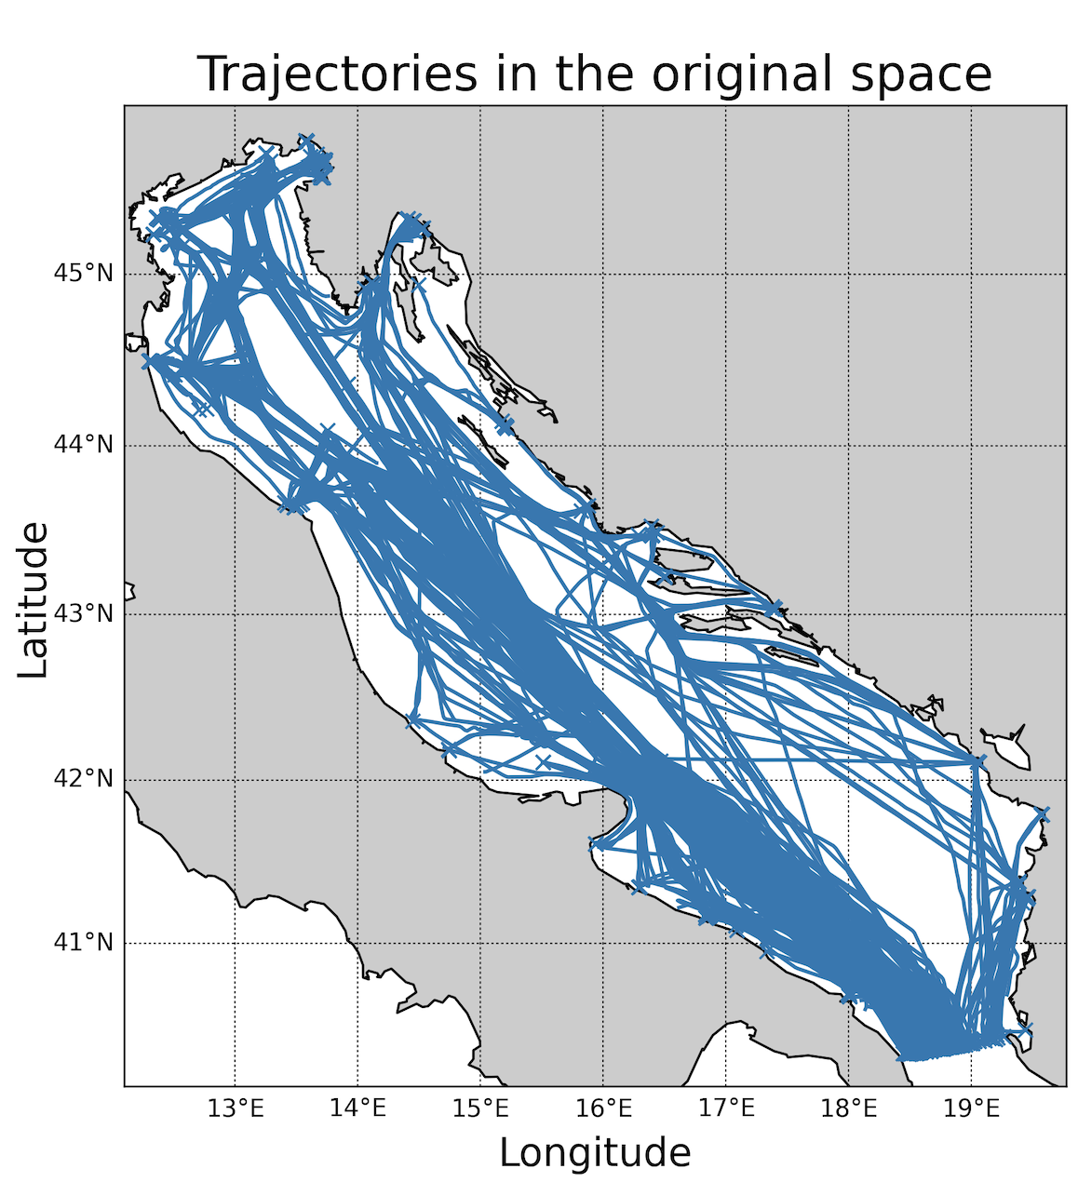
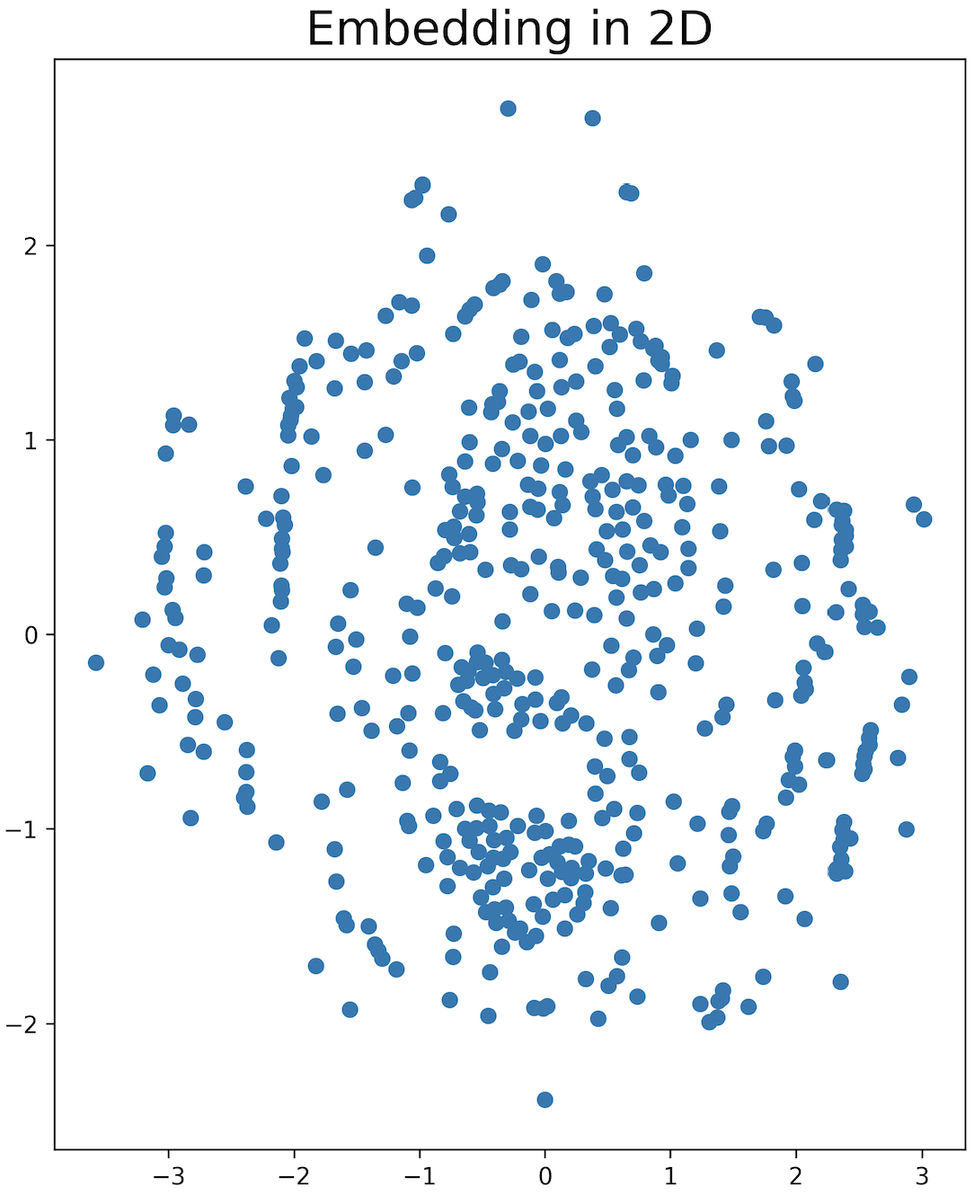
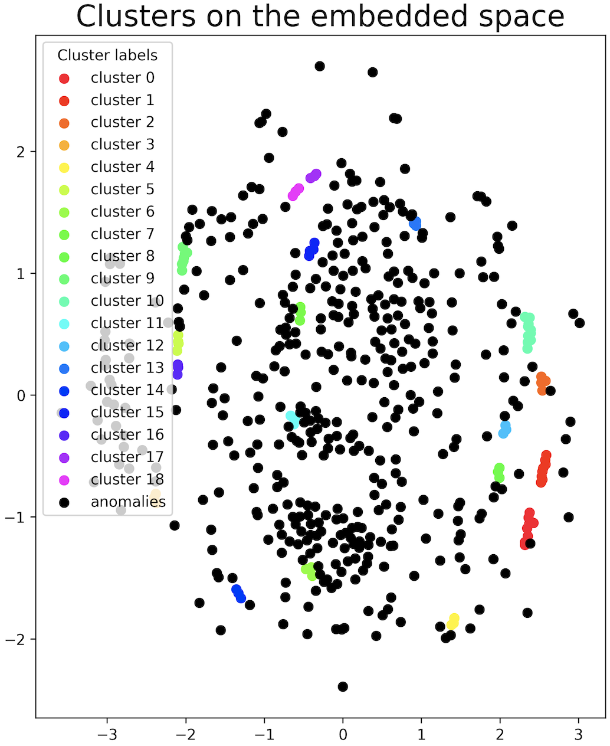
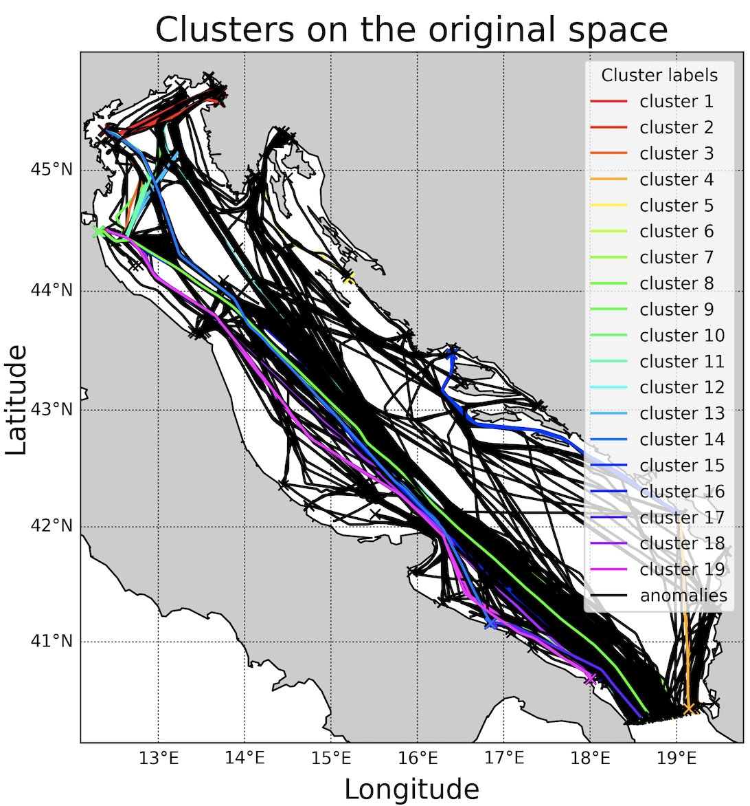
Anomaly Detection: Adriatic Results
For this experiment 500 tracks have been used.
Transformer-Based Model for Vessel Route Forecasting and Anomaly Detection - Alessandro Marzilli
Notes:
For the anomaly detection task, we conducted experiments for both datasets. Let's present first the experiment for the Adriatic Sea. For this experiment 500 tracks have been used.
The second image shows the application of the mds method, the third and the fourth images show the application of the dbscan algorithm.

Slide 20
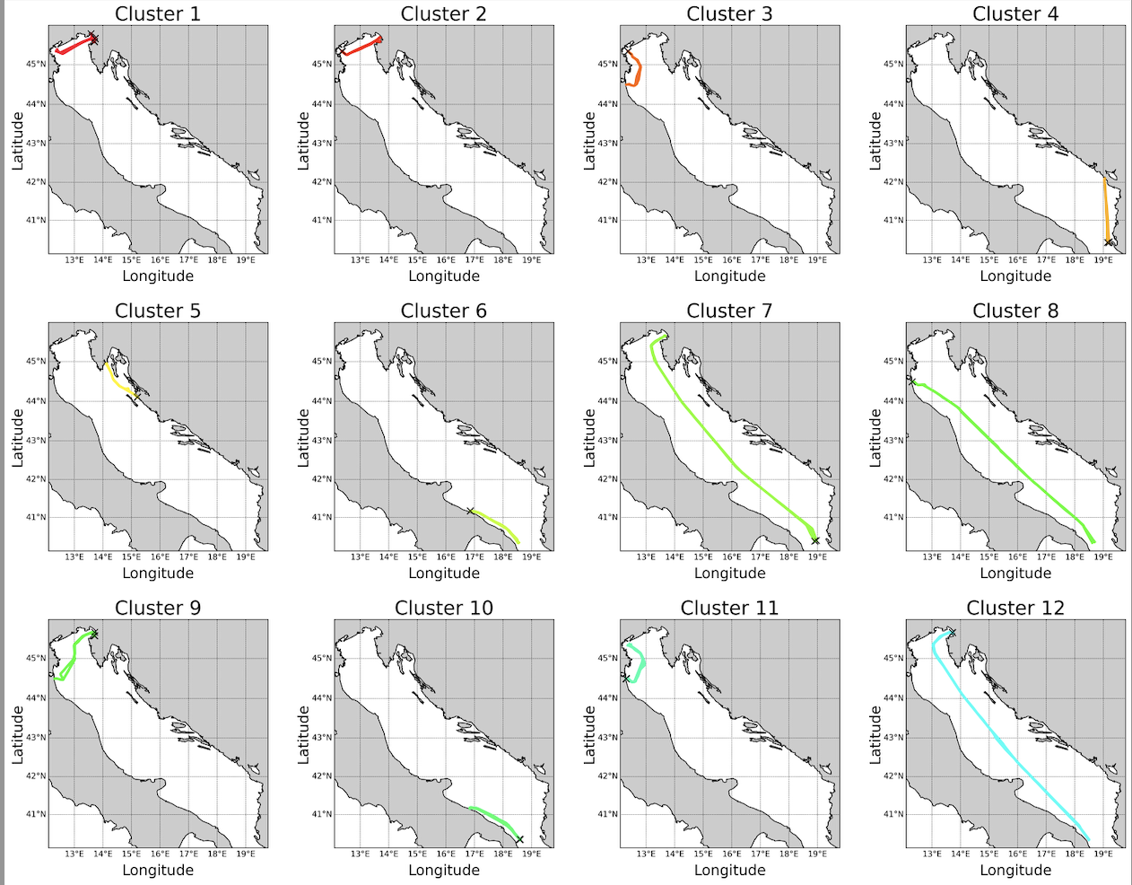
Anomaly Detection: Adriatic Results
The method correctly classifies 19 clusters ( a subset of them is shown).
Transformer-Based Model for Vessel Route Forecasting and Anomaly Detection - Alessandro Marzilli
Notes:
The method correctly classifies 19 clusters (only a subset of them is shown).

Slide 21
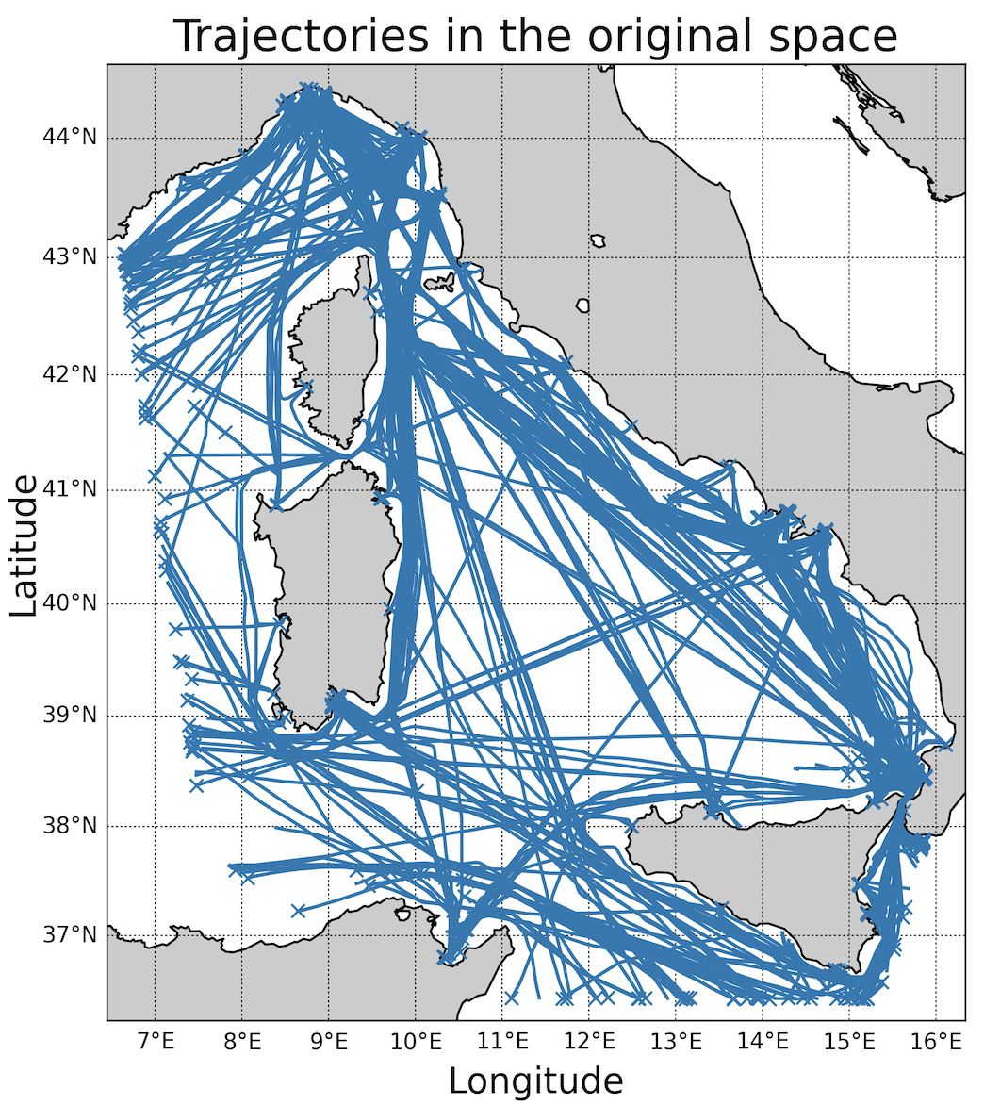
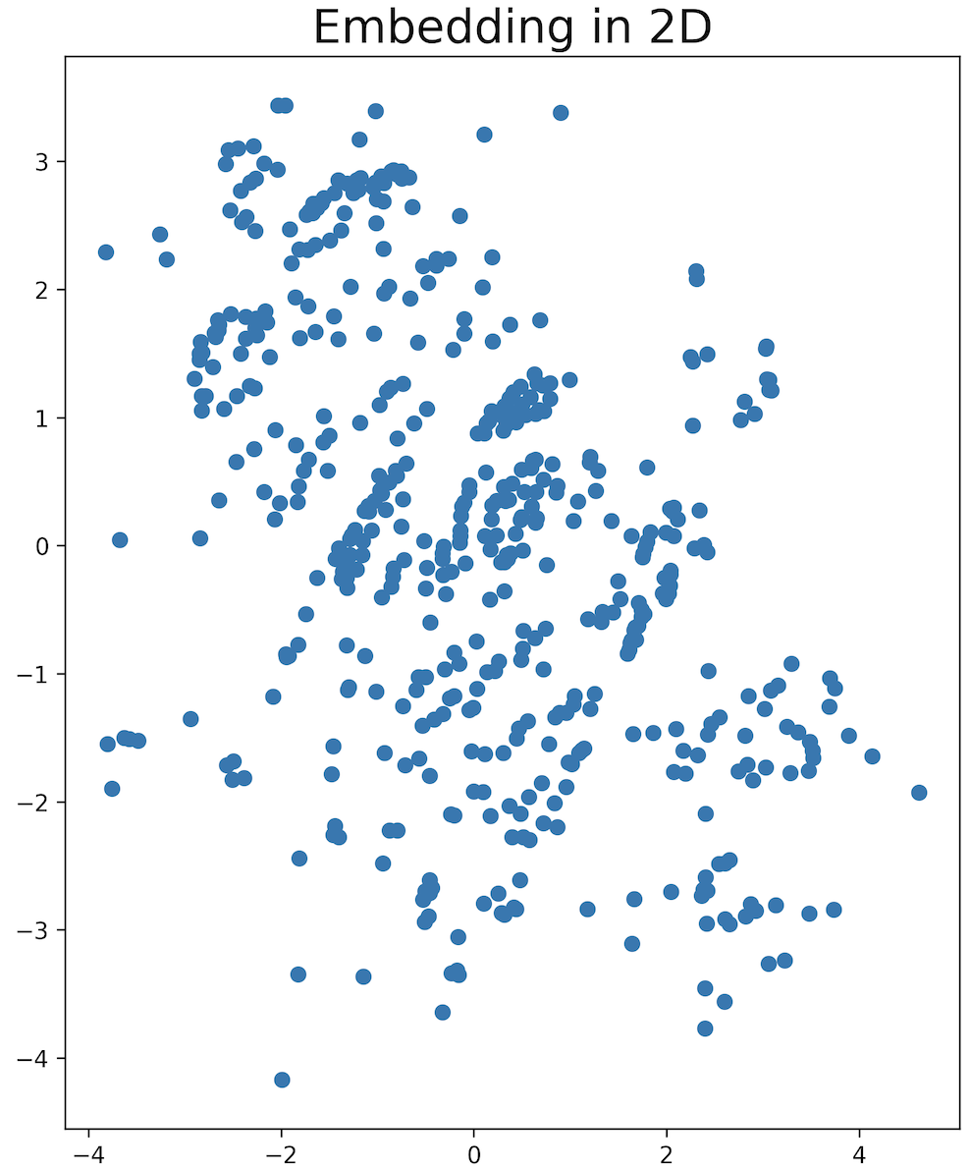
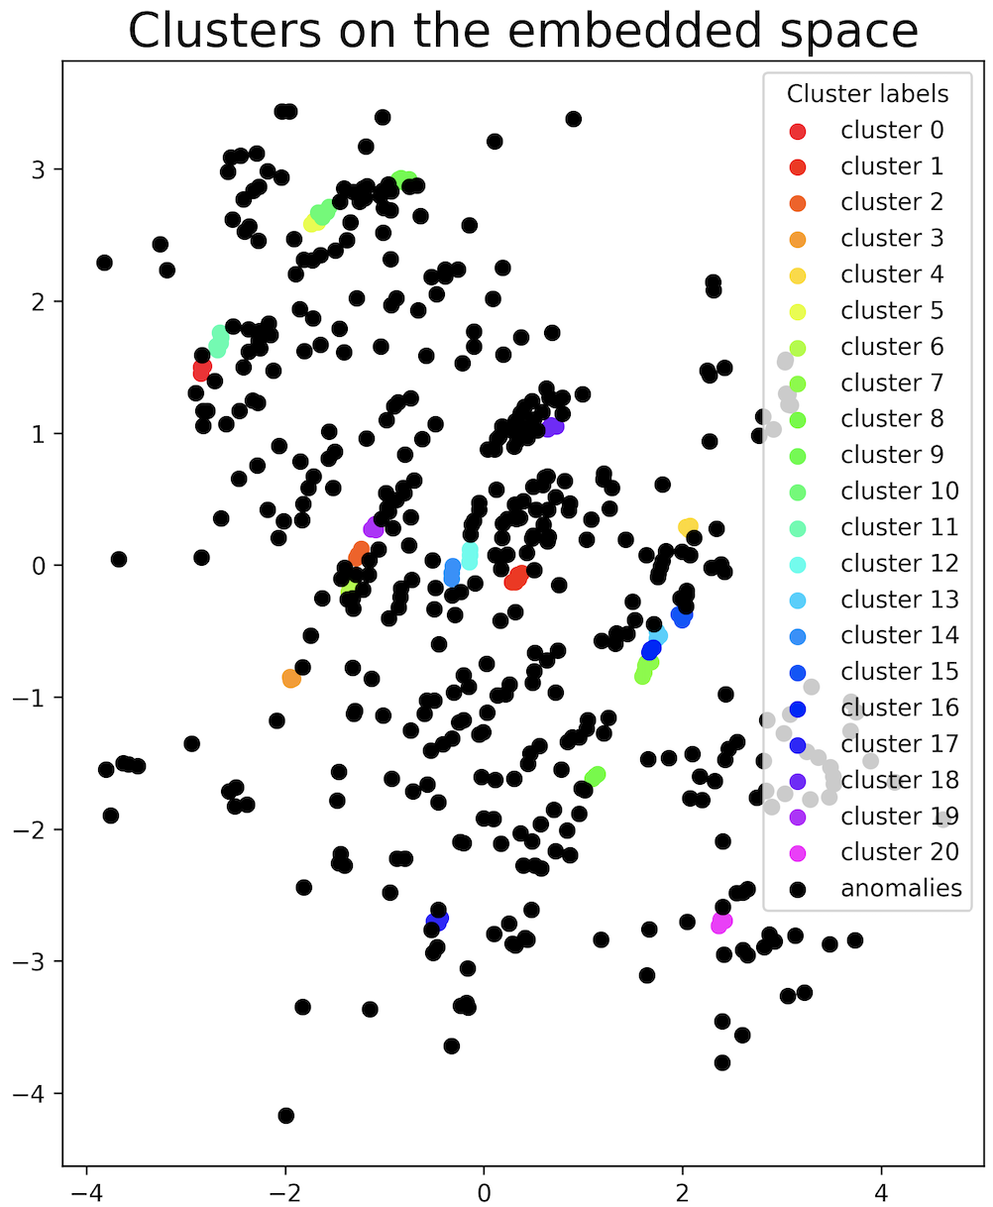
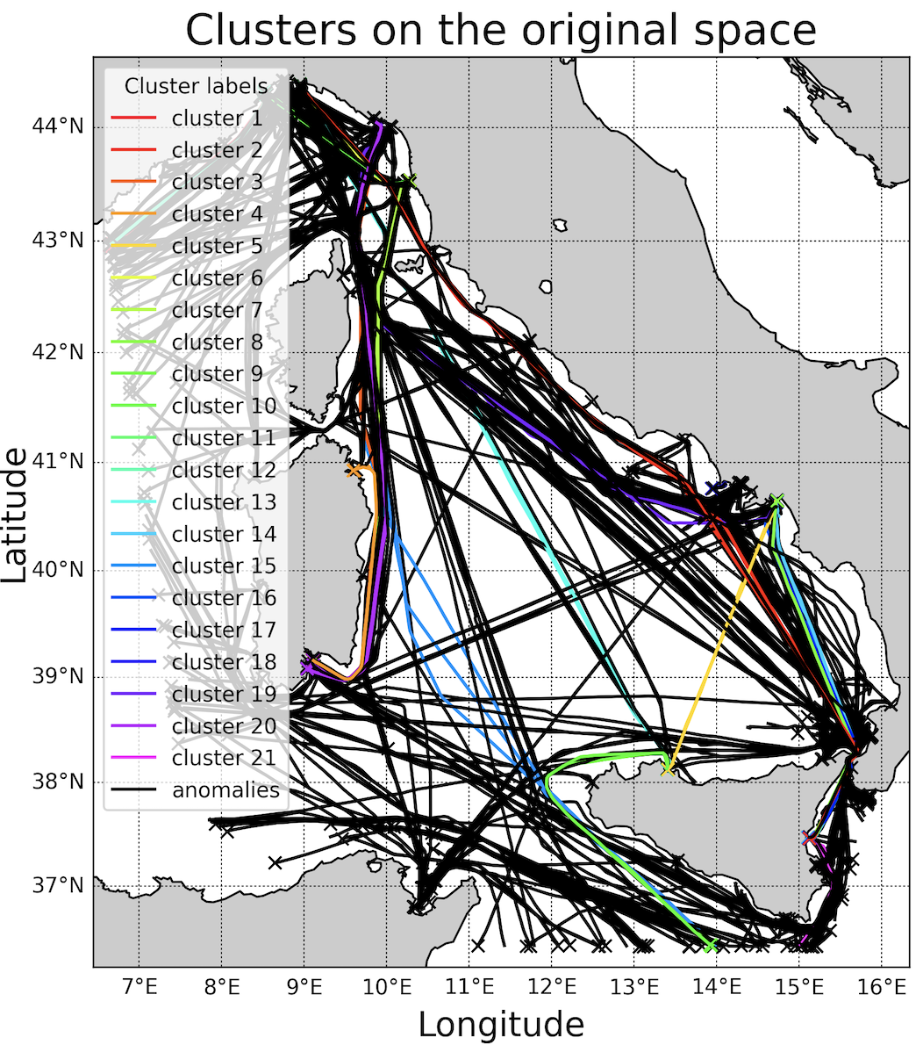
Anomaly Detection: Tyrrhenian Results
For this experiment 500 tracks have been used.
Transformer-Based Model for Vessel Route Forecasting and Anomaly Detection - Alessandro Marzilli
Notes:
For the experiment related to the Tyrrhenian Sea 500 tracks have been used.

Slide 22
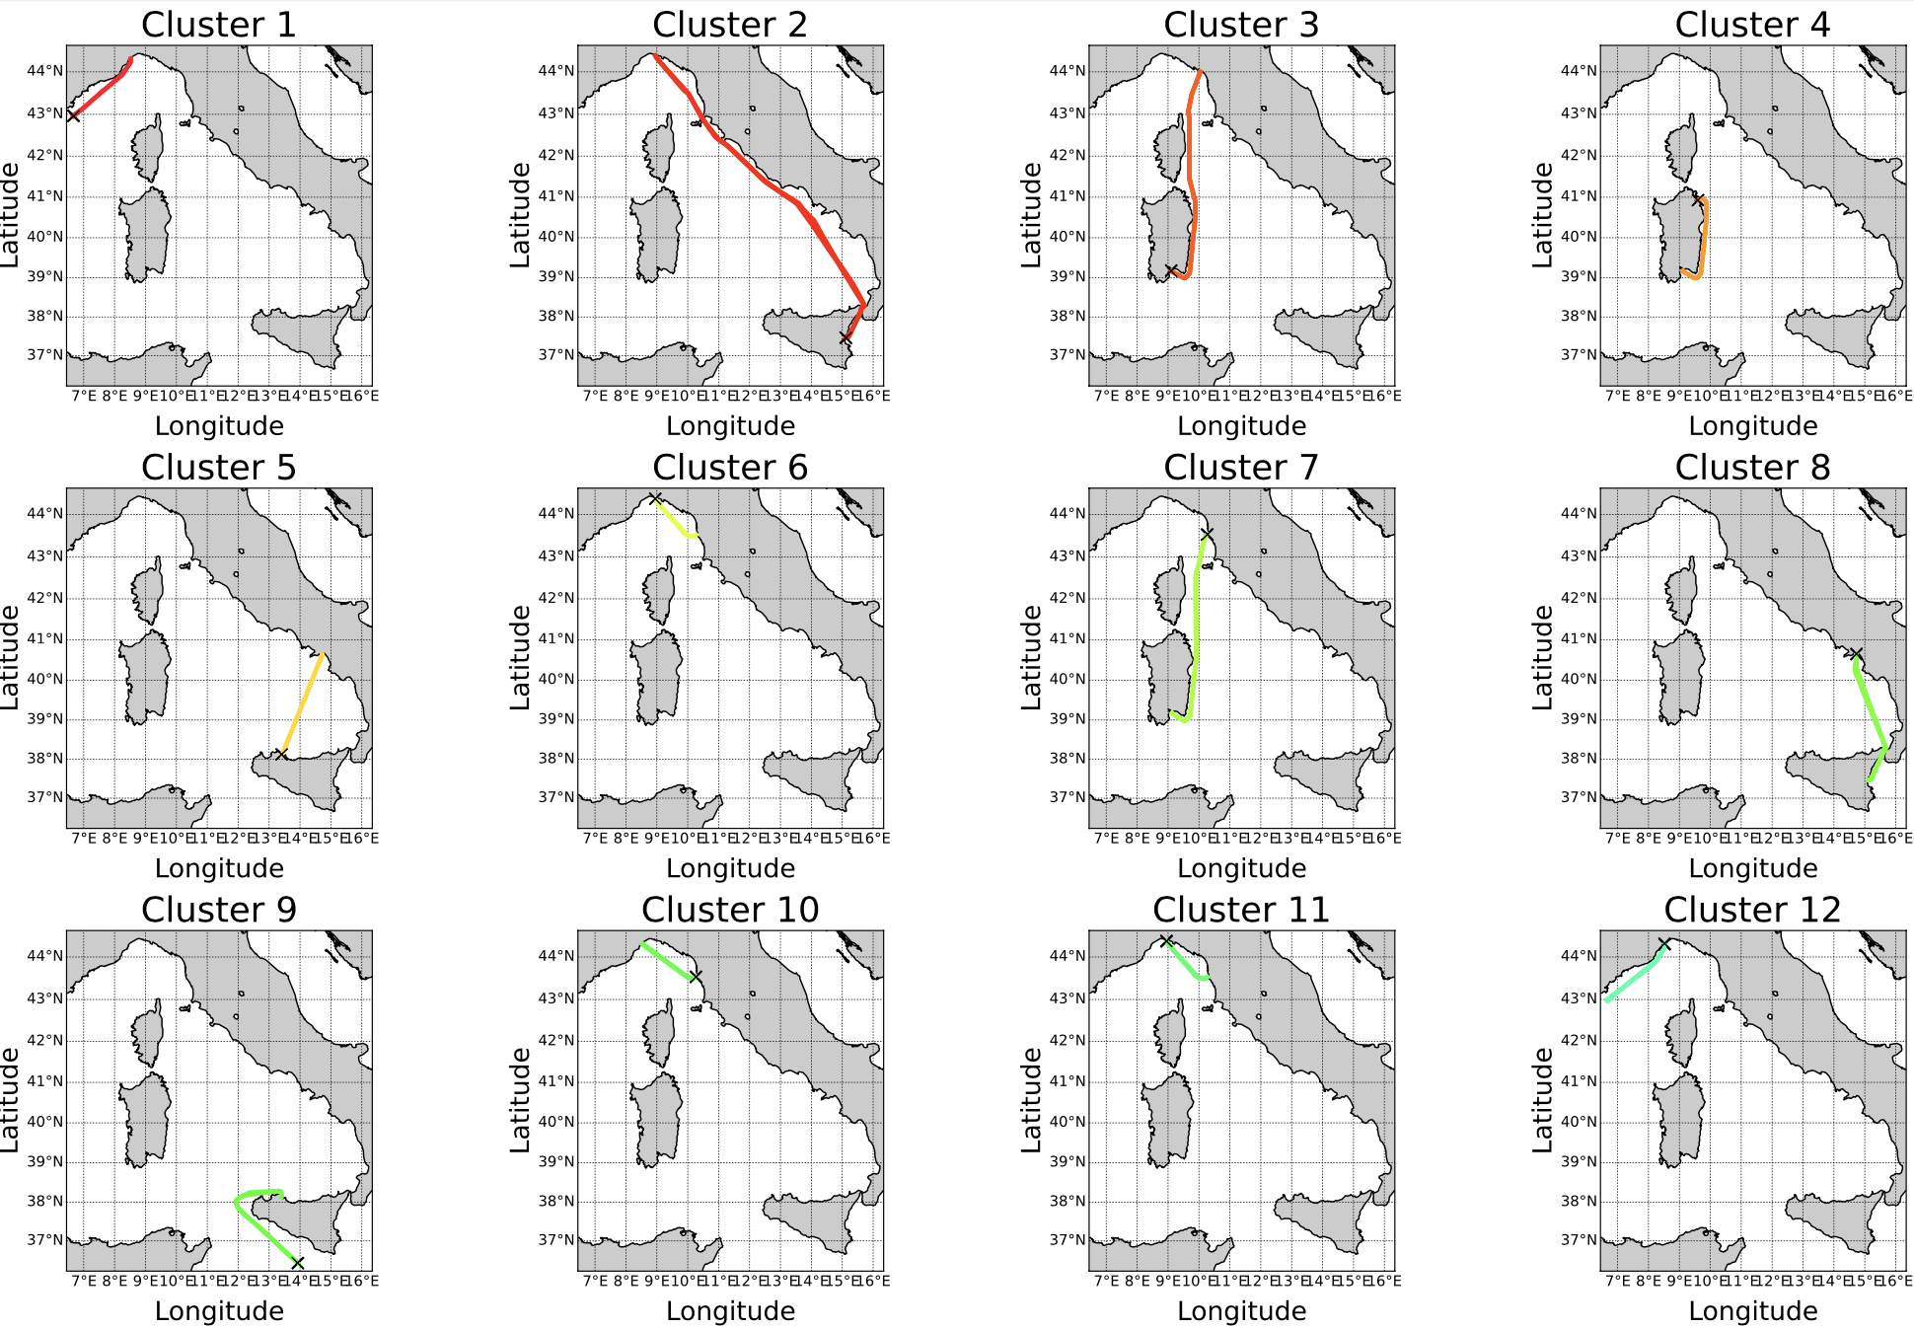
Anomaly Detection: Tyrrhenian Results
The method correctly classifies 21 clusters ( a subset of them is shown).
Transformer-Based Model for Vessel Route Forecasting and Anomaly Detection - Alessandro Marzilli
Notes:
The method correctly classifies 21 clusters (only a subset of them is shown).

Slide 23
5. Future Works
Consider a large set of trajectories for the anomaly detection task to improve the promising results already obtained
Integrate the detection of other anomalies such as: close approach, zone entry and port arrival
Prediction of the Estimated Time of Arrival (ETA)
Integrate in the datasets AIS data coming from AIS satellites
Transformer-Based Model for Vessel Route Forecasting and Anomaly Detection - Alessandro Marzilli

Slide 24
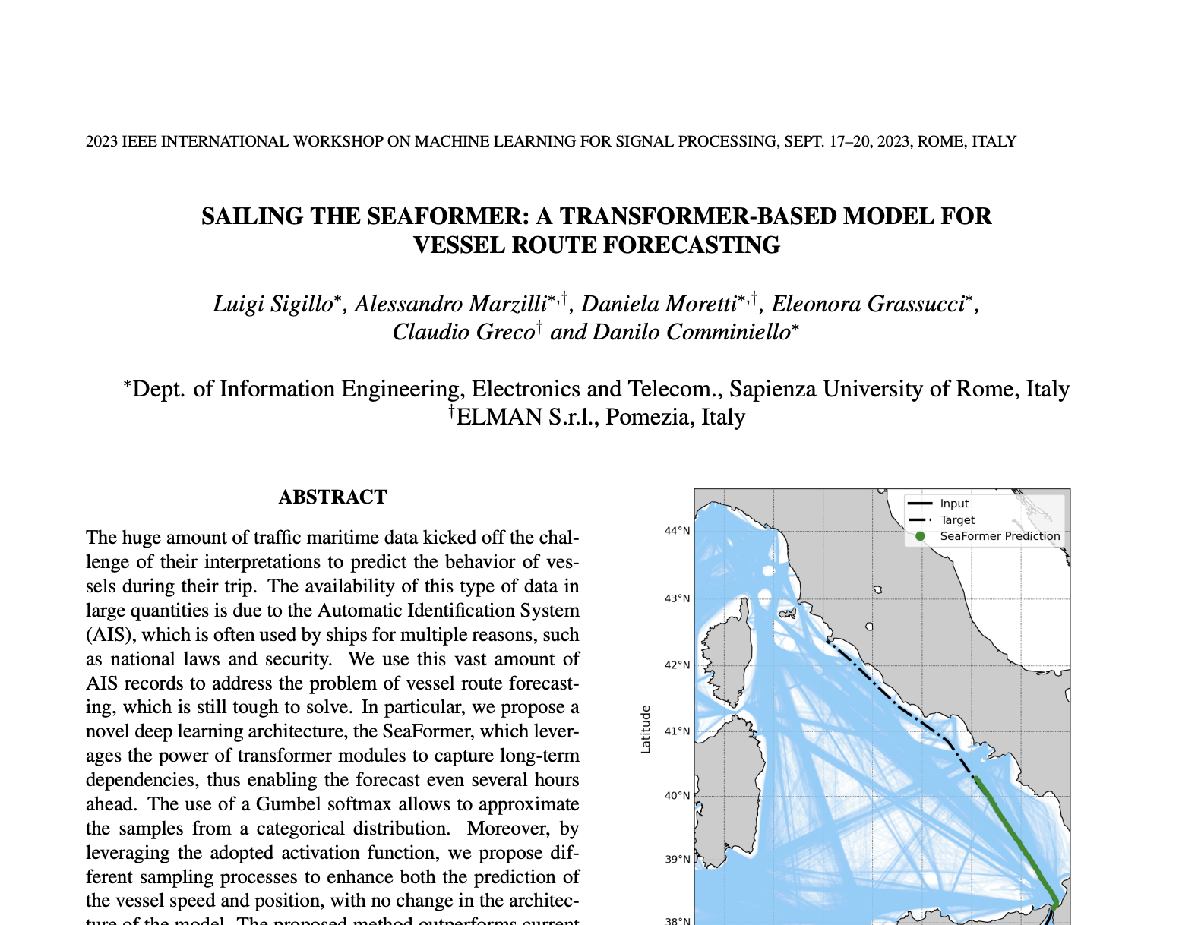
Publication
We will also present the paper “Sailing the SeaFormer: a Transformer-based Model for Vessel Route Forecasting” at the “IEEE International Workshop on Machine Learning for Signal Processing”
Transformer-Based Model for Vessel Route Forecasting and Anomaly Detection - Alessandro Marzilli
Notes:
I’m happy to announce that we wrote a scientific paper: “Sailing the SeaFormer: a Transformer-based Model for Vessel Route Forecasting” that has been accepted to the “IEEE International Workshop on Machine Learning for Signal Processing” that will take place in Rome in September.

Slide 25
Thank you for the attention!

